Slide 1
Gui specifications
Modular canvas using DHTML, AJAX and SilverLight if needed
IDE like IGoogle style with mini working areas
Life cycle similar to wizard
Use Case guest user:
  Form Filling(consistency control)
Use Case registered user:
  Authentication (in middle of the screen)
  Creation or Editing of previous project(w.f. editor)
  Publishing and Form Filling(consistency control)

Slide 2
Main Page Area Subdivision
Main page organized in 4 widgets:
Link to workflow editor and logout
Link to the form list to be filled by the user
(Pop up)
Visualization of favourite form results and link to other forms’ statistics
Tutorial

Slide 3
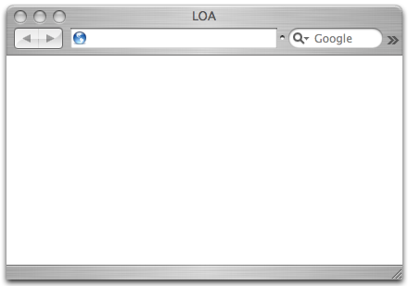


Form selection
Authentication
FORMS
preview
user
Form list
Form 1
-
-
-
-
-
Form n
passw
network
security
popup
- Workflow editor
- Logout
Forms to fill
pop-up
+ CSS
+ WORKFLOW
+ FIELD
+ XML(XSD)
+ DINAMIC CONTROL
STATS for a
favourite form
Link to the other statistiscs
HELP
Presentation
Results
RESULTS
Selection forms
Form 1
…
Form n
Users profile (??)
Pag 1/3

Slide 4
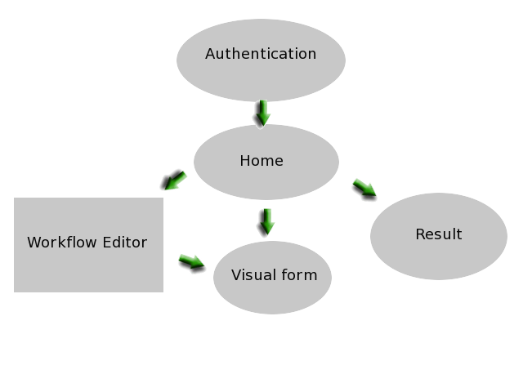

Slide 5
Presentation
Pag 1/3
Form page made of:
  css sent by theme editro
  XSD sent by Workflow editor
  Rendered object sent by Fields
  Dinamic consistency controls

Slide 6
Questions
Internal state or comunication with server?
Has a user an internal profile?
Which method should be used to build statistics and if the single answers are visible?
Shall we handle the selection of users who will receieve the forms?

